Slide 1
Disaster Safety Tips in Gifu Prefecture
What you gotta know to be safe!

Slide 2
Content warning.
We’re going to be discussing natural disasters. Earthquakes, typhoons; we will not be showing any imagery of previous disasters.
If you feel overwhelmed, or if you need to step out to get a breath of fresh air, please feel free to do so.

Slide 3
Let’s start with a question
What natural disasters do you think we get the most of in Gifu?
What knowledge do you think you need to stay safe during these events?
This Photo by Unknown Author is licensed under CC BY-NC
Notes:
Technically, it’s typhoon level rains
You’ll learn it in today’s presentation

Slide 4
General outline
National Disaster Japanese Terminology
What Should You (Generally) Do in an Emergency
Looking at Disaster Kits
Q & A and Discussion

Slide 5
Where can we find this information?
If you’re looking for more resources or tips, the newly updated Gifu JETS website has all this information.
[#]Preparation - GIFU JETS (weebly.com)
[#]Earthquakes - GIFU JETS (weebly.com)
[#]Typhoons - GIFU JETS (weebly.com)
Notes:
PLUG the website!!!!!!

Slide 6
Japanese disaster terminology: warnings
News outlets will categorize the severity of the disaster based on the type of warning that they send out. These are meant to help gauge and assess the level of the disaster.
An advisory is typically issued in advance for areas where conditions could lead to severe weather, while a warning is issued for areas where severe weather is imminent or occurring.
In case of severe weather, like typhoons, or earthquakes, you may hear an alarm play through your phone or your town's PA system.
They will also play during volcanic eruptions, and tsunamis.
English | Japanese and Romaji
Advisory | 注意報 chuuihou
Warning | 警報 keihou
Emergency Warning | 特別警報 tokubetsukeihou
Notes:
Talk about warnings during snow and rainy seasons,

Slide 7
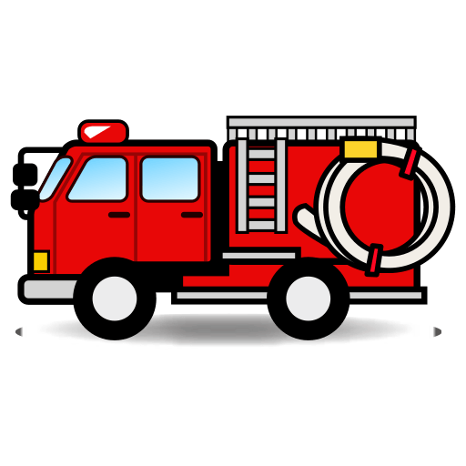
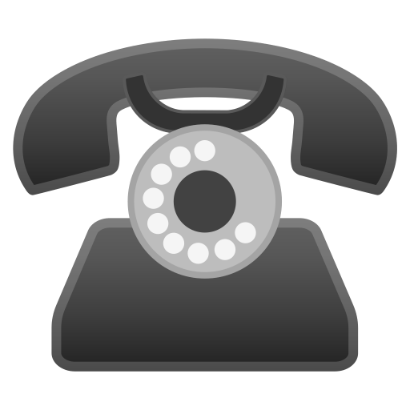
Important phone numbers!!!!!
Who? | Phone Number
Police | 110
Fire / Ambulance Emergency Rescue | 119
Safety confirmation during a disaster | 171
Quick note: For the 171 number, it’s meant to be
used to leave a message and let your friends and loved ones know your safe.
Please take a minute to take a photo / write down these numbers in your phones or on a piece of paper!!!
Notes:
Mention how nobody told me the phone numbers for police

Slide 8
More specific Vocabulary and terms
This website from the Japan Times has it all.
[#]Japanese vocabulary for disasters - The Japan Times
It goes into more detail into the specific natural disasters, like phrases for earthquakes.
Notes:
Show a quick preview of the specific words

Slide 9
General advice for any sort of disaster!
Try to stay calm.
Have some sort of communication readily accessible.
Staying in one place is generally safer, except in instances where it’s OBVIOUSLY not safe to do so.

Slide 10
What do we do?
What to do during an earthquake?
What about a typhoon?
Notes:
Have people talk about what to do during these natural disasters
Give around maybe 5 minutes? 7 minutes?

Slide 11
Gifu has had its fair share of earthquakes
Gifu Prefecture has been a victim of great earthquakes in the past, such as the 1891 Great Nobi Earthquake and the 1923 Great Kanto Earthquake.
Today, people are even more prepared in case of large-scale natural disasters.
Of the big three natural disasters that Japan faces (earthquakes, tsunamis, and typhoons), here in Gifu we are most at risk of earthquakes and their aftershocks.

Slide 12
Earthquakes and what to do
Know where your emergency kit and your evacuation sites are.
Fasten appliances and objects likely to fallen within your home, if possible.
Turn off your gas and electricity to avoid more damage.
Gifu has tremors, but it has been a while since we've had one; it never hurts to be prepared!
During the actual earthquake:
1) Drop: Stay low to the ground. Get away from tall furniture like bookshelves if you’re indoors. STAY AWAY FROM WINDOWS. Preferably, something close to a load-bearing wall.
2) Cover: Get under a desk or a bed. Cover the back of your neck with a pillow, and if you’ve got a helmet, WEAR IT!
3) Hold: Hold on to your cover, wait it out until the shaking stops.
No matter where you are, at home or away, find shelter and stay safe using these rules!
Notes:
“You know the procedure for fires? Stop drop and roll? Earthquake shave Drop Cover Hold

Slide 13
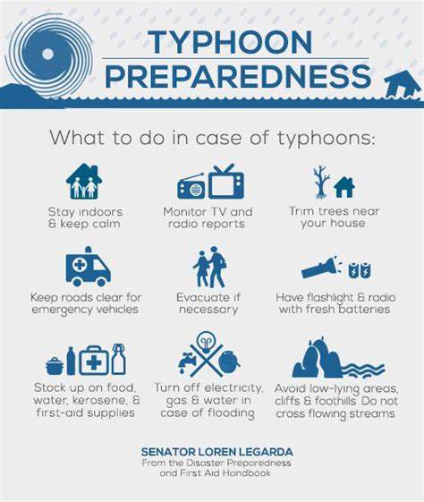
What about typhoons?
Keep yourself informed about the typhoons path. NHK and the internet are your best resources for this.
STAY INDOORS PLEASE!!!
Know where your emergency kit is. Keep it somewhere close, like in your genkan, by the bed, or a closet close to your front door if you have one.
Laundry poles are best taken down from their hooks and secured to the floor of your veranda, or even brought inside if you've got the space. Try to do this BEFORE the weather gets bad to avoid damage and accidents.
During the actual typhoon
Stay indoors: Strong winds are no joke.
Be ready to evacuate if necessary: Again, know where your evacuation site is. Stay indoors until that order is made.
Have some sort of communication: Having a charged cell phone is your best friend.

Slide 14
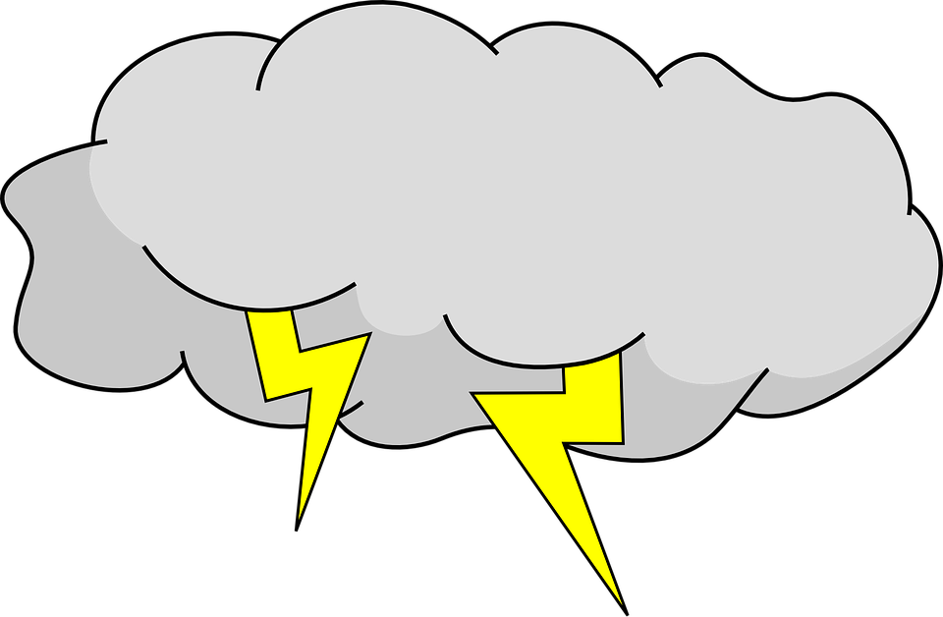
Quick tangent: Lightning storms
Japanese lightning storms can last up to an hour long during the summer months.
If you’re indoors:
Unplug your electrical appliances and try to stay in the center of your room. Being indoors is much safer than being outdoors
If you’re outdoors:
Try to find some sort of cover or shelter, preferably NOT under a tree or the eaves of a roof. Being outside in a large open space like a sports field or beach increases your chance of getting struck by lightning.
Don’t hold an umbrella, since that can act as a lightning rod.
If you cannot get indoors, get low to the ground and cover your head and neck.

Slide 15
For the mountain folk…
The more mountainous regions of Gifu can experience landslides and flooding from snowmelt.
Do not evacuate until you're given notice; the elderly are usually evacuated first because they take more time to get to safety. Better safe than sorry!
Since these disasters are often localized, it’s best to follow your local news outlets for information.
GENERALLY!
Know your evac sites
Keep a prepared emergency safety kit
Have access to cellular communications
If you have more questions about this topic, please feel free to ask those around you during the Q&A sessions

Slide 16
Looking at an emergency kit
Kits can be prepared at home or bought in home department stores and online.
If you're making your own, you can customize it for more specific needs, like if you have kids, a pet, a partner, or specfic medication and products.
An emergency kit should include:
Water (4 liters(1 gallon) per person per day. Change water every 3-5 months)
Food (canned or pre-cooked, requiring no heat or water)
Flashlight with spare batteries and bulbs
Radio (battery operated with spare batteries)
Large plastic trash bags (for waste, water protection or temporary blanket)
Hand soap and/or disinfecting hand cleaner gel that does not require water
Toilet paper
Feminine hygiene supplies
Essential medications as required; glasses if you normally wear contacts
Paper plates, cups, plastic utensils, cooking foil, plastic wrap (wrapped around plates so that they were re-usable) and paper towels
First Aid kit with instructions
Yen in small bills (ATMs may not work after a disaster), with coins and phone cards for public phones.
Completed print out of emergency pocket guide
Print out of important contact information (supervisor, embassy, school numbers, home country contact numbers)
Notes:
Holy moly look at all that stuff!!!
Can be bought from amazon or made piecemeal at home

Slide 17
The Japanese meteorological agency (the JMA)
https://www.jma.go.jp/jma/indexe.html
This website follows and tracks weather events and natural disasters live.
Can be also read fully in English!
I recommend you add this webpage to your bookmarks for expediency!

Slide 18
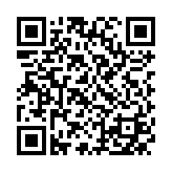
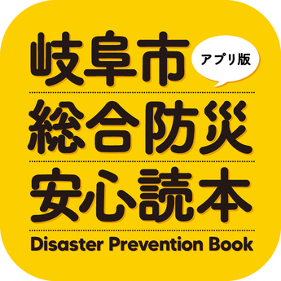
The Gifu disaster prevention book
App that shows useful information for reading hazard maps, as well as info for more localized weather events.
Can be read in English, but you might need to rely on translation software for some parts.
Notes:
Please scan this with your phones, gives access to an app that shows how to read disaster maps and stuff

Slide 19
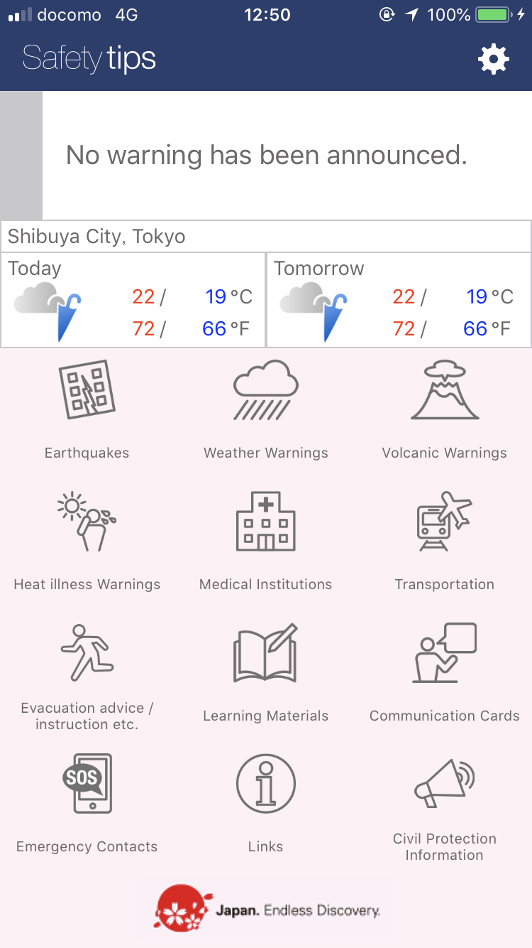
Safety Tips App by JNTO
Created by the Japan National Tourism Organization will all information related to local weather forecasts and natural disaster guidance.
Why use this app?
Provides a large range of useful phrases for emergencies.
Push notifications for weather warnings and disasters.
Offers evacuation guidelines when needed.
Available on iOS and Android.

Slide 20
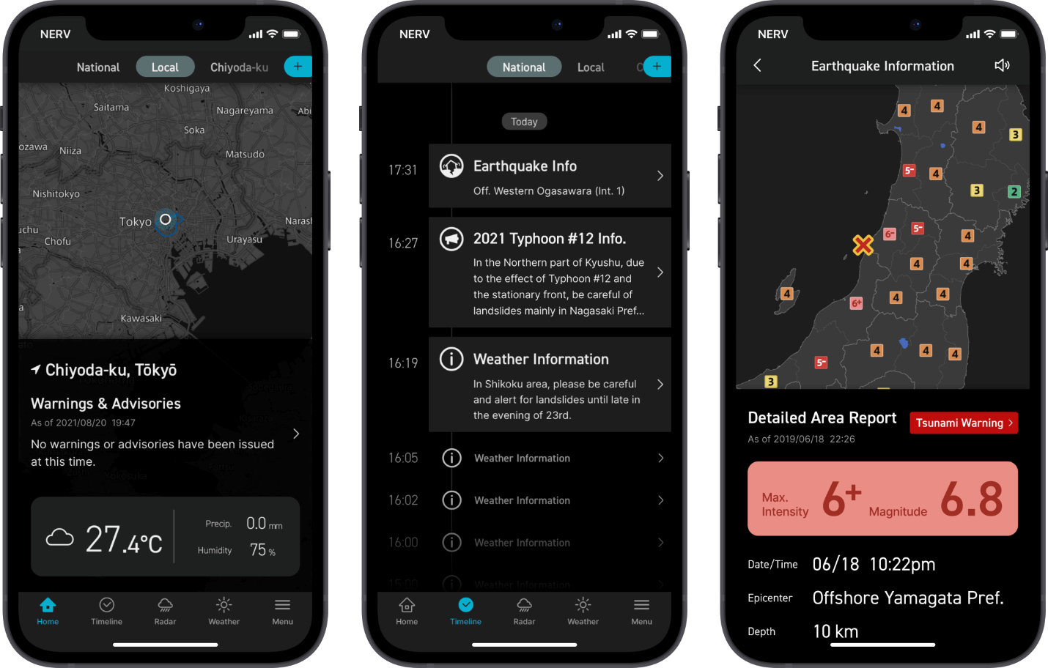
NERV Disaster Prevention
Inspired by EVA, this app prides itself in being the fastest to notify users when a disaster occurs.
User-friendly with great accessibility options for people with visual impairment.
Updates on anything from floods and landslides to tsunami and earthquakes.
Real-time updates on any information related to Japan's weather.
Available on iOS and Android.

Slide 21
Staying calm during a natural disaster
We can prevent accidents and injury by keeping a calm demeanor during these events.
For waiting out disasters, try to do something that will keep you calm:
Play a game
Call a loved one
Read a book
Watch a movie.

Slide 22
Discussion and Q&A

