Slide 1
Japanese study SKILLS
A Focus on Self-Study

Slide 2
My Situation THEN Now
An idiot
Never formally studied Japanese
Started when I found out I was on JET.
Did the basics before coming here – katakana and hiragana
Knew very basic kanji, grammar and vocab, possibly enough to pass JLPT N5
Came to Japan, realized I couldn’t understand a word anyone was saying.
A genius
Now at N2 level, took N1 in December.
Can read native-level stuff, albeit looking up some words and not always particularly fast
Reading and kanji skills are strong; speaking and listening are weakest.
Still have problems with speaking due to not practicing enough
Listening has developed organically due to living here, but I’m not strict enough with listening study.

Slide 3
What’s YOUR FOCUS?
Your approach to studying and your study methods will largely be determined by what you want from Japanese.
Do you want to be able to talk to other teachers?
Do you want to pass the JLPT?
Do you want to work for a Japanese company?
Do you want to read your favorite manga/watch your favorite anime/play your favorite game in Japanese?
Even if you don’t have a particular reason for studying, it’s good to find something to focus on. Simply wanting to be “fluent” isn’t a great end goal, as it’s vague and ill-defined.

Slide 4
THE JLPT
A standardized International test. Apply at http://info.jees-jlpt.jp/#
Held twice a year in July and December.
In Gifu, it’s usually held at one of the two Universities – Gifu Daigaku or Tokai Gakuin.
Goes from N5 (beginner) to N1 (advanced).
Most non-teaching jobs require N1 or at the least N2.
Other levels aren’t useless though – still a qualification to stick on your CV.
Test consists of Kanji/ Vocab/Grammar, Reading and Listening sections. No speaking section.
Multiple choice questions, quite old-fashioned and relying on rote-memorization.
Scoring is quite lenient, only needing around 90/180 to pass. However there is a minimum score of 19/60 needed for each section.

Slide 5
My Approach
A textbook learner.
90% of my studying has been at my desk during free periods.
Focus has been on passing the JLPT and progressing through the levels each year.
The JLPT gives me a focus and an end goal to work towards.
When starting a new level for the first time, I tend to work in the order of: Kanji > Vocab > Grammar > Reading > Listening.
Ditch romaji as soon as possible. It’s a crutch and it can mess with your pronunciation too.
Don’t be scared of kanji. A lot of textbooks start out with just hiragana/katakana and stay with them for too long. Learn kanji from day one. Some of the simplest kanji are used the most frequently.
I don’t learn all the different readings of a kanji, I learn them through learning words. From the start, whenever I learned a new word, I would learn the kanji for it too.

Slide 6
Pros of Self-Study
Independence
Freedom – you pick what you study and when to study.
Can be cheaper than expensive classes – unless you buy loads of textbooks, though you can sell these on.
You can progress a lot faster than in classes, if you’re dedicated enough.
You can make it as immersive as possible and blur the line between studying and recreation.
You’re able to focus on non-academic media, such as books, YouTube, TV etc.

Slide 7
Cons of Self-study
Needs discipline and motivation.
Your skills don’t always develop equally.
A danger of “studying for the test”, especially if you’re doing the JLPT.
Sticking with familiar study methods and getting in a rut.
No feedback or evaluation. Difficult to realize when mistakes are being made, or how to correct them.
Needs self-awareness and self-correction, especially in regards to weakpoints.
Weakpoints need to actively be addressed. I don’t study listening as it’s the part I like the least, therefore I study it the least. Classes would give you much more balance.
The danger of procrastination – it’s all too easy to be sitting at your desk intending to study, but then fall into a reddit blackhole of which it is impossible to emerge.
Make your learning ACTIVE not PASSIVE – this is especially important when you’re doing more casual self-study, like watching YouTube, or an anime, or talking to a friend in Japanese.

Slide 8
Anki/SRS/FLashcards
Often a key component of any self-study routine. Plenty of ready-made decks out there, or you can make your own (though takes quite a lot of time inputting them).
Many recommend the Anki 2K/6K/10K premade vocab decks. There are also ones tailored to the JLPT.
Not just limited to vocab drills, you can include grammar, full sentences, ones with audio etc.
Needs self-discipline to do regularly every day. Easy to do at your desk, on your phone, on the train, etc.
Shouldn’t be the main focus of your studies though – a daily supplement to other things.
Be careful not to get a backlog – you don’t want to do 200 cards just to get back on track.
If you’re making cards yourself, you need to consider what makes a “good” and “bad” flashcard:
http://ankiguide.com/7-common-flashcard-mistakes-to-avoid/
https://blog.fluent-forever.com/create-better-flashcards/
There are other sites/programs instead of Anki: https://www.tofugu.com/japanese/spaced-repetition/

Slide 9
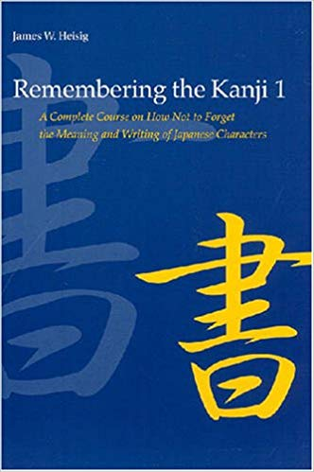
Kanji and mnemonics
Don’t be scared of kanji, don’t put off learning them.
The Japanese way of learning kanji – by rote memory, writing them down hundreds of times – is inefficient.
You’re probably not going to need to write things by that often. Learn how to write until you get basic stroke order down.
There are quite a few kanji mnemonic tools out there – the book “Remembering the Kanji” is popular with beginners, as is the Wani Kani SRS tool https://www.wanikani.com/ Wani Kani isn’t free, but you can dabble with the first few levels as a trial.
Mnemonics rely on a imagined story to create a visual link between this and a kanji. For example, 休 contains the “man” radical and the “tree” radical, it’s a man relaxing against a tree in the sun, conjuring up the image of “rest”.
RTK doesn’t tell you the kanji readings. Wani Kani includes a reading mnemonic too.

Slide 10
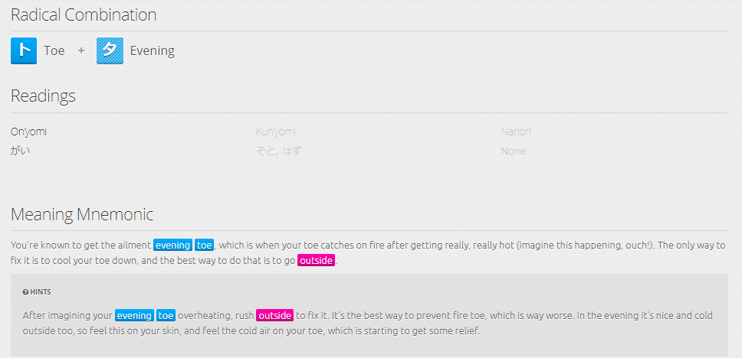
Kanji and mnemonics cont.
An example from Wani Kani for 外:

Slide 11
Kanji and mnemonics cont.
If you start a mnemonics course, you often have to stick with it in order for it to pay off long-term.
Mnemonics need repeated reinforcement.
My approach is generally to learn a new word, in kanji, then go learn other words using that same kanji. Often this reinforces meaning. For example, 外国、海外、外交、以外、郊外 all contain some notion of “outside”.
I find mnemonics to be a lot of grunt work just for one word/kanji. Uses a lot of English too.
Some kanjis like 生 have many readings. Often a mnemonic covers one of them, for example 生as “せい”, so you might have some trouble remembering 生きる or 誕生日.
However, if you’re struggling with a particular kanji or a reading, a mnemonic can help.
I prefer seeing the kanji in more “natural” ways, or in full sentences, and getting used to its meaning through content.

Slide 12
Comprehensible Input
You’ll be deciding what sort of content you study. It’s important to not get stuck in a comfort zone, but also not to over-reach.
You should aim for things that are your current level “+1”. Just beyond your level of understanding, but not completely unintelligible.
This will help you to learn things more naturally, at a regular pace.
Attempt to learn something that is “+5” or way ahead of your current level, is often not an efficient use of your time. Brute forcing your way into more advanced content is counter-productive.
For SRS drills, there should only be one “unknown” on each card/in each sentence. You need to focus on that “+1” rather than trying to remember multiple things at once.

Slide 13
Shadowing/Speaking
As a self-studier, it can be hard to get adequate speaking practice.
A lot of it is memorizing sample sentences and repeating them, so you won’t create any output yourself.
However I did find that some key phrases or responses stuck in my head, and I found myself hearing them said elsewhere and noticing them more.
Though nothing replaces another human being for speaking practice – just if it is studying, make sure you get correction and feedback. Don’t let them ignore your mistakes.

Slide 14
Generic Motivational ADVICE
Don’t get disheartened.
There’s no one-size-fits-all study method. There’s no “get rich quick” scheme either.
Language learning isn’t a constant upward curve – it has peaks and troughs.
The “Intermediate Plateau” is a thing. A point where you know enough to get by, but progressing to the higher level, native stuff feels like a big step up.
Your skills won’t develop equally either.
Don’t compare yourself to others. Everyone gets language-envy and there’s always going to be someone better at Japanese than you.
You’ll probably learn more from one mistake than one right answer.

Slide 15
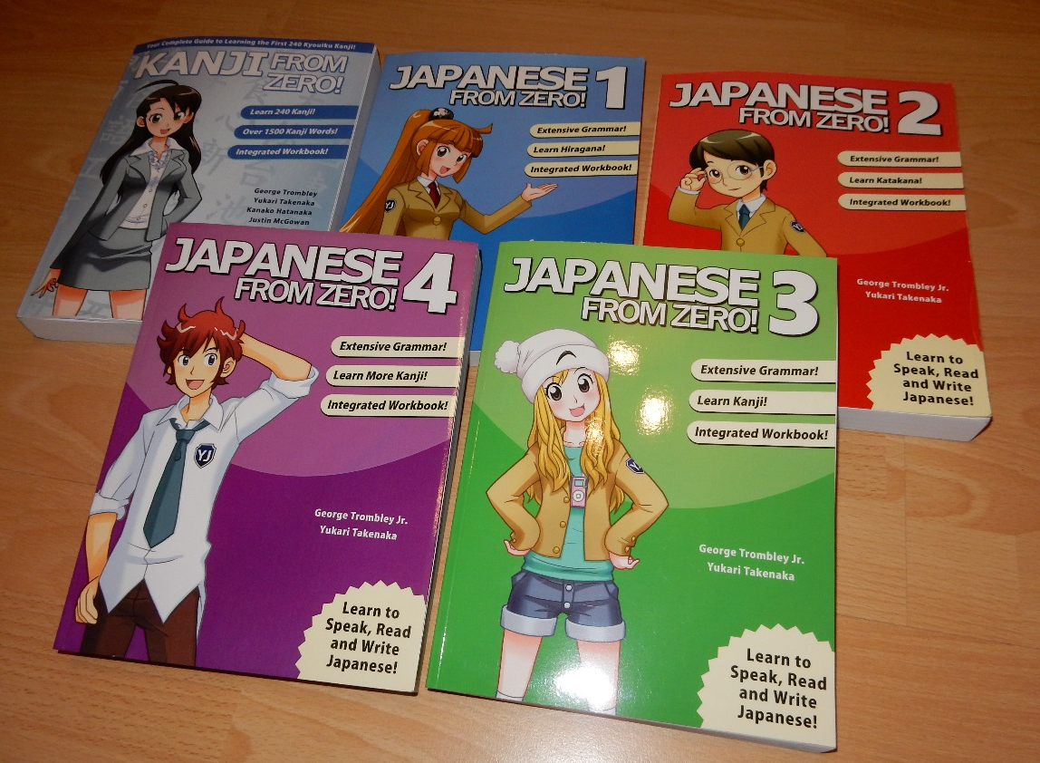
TEXTBOOK RESOURCES – Japanese from Zero Series
PROS
Very easy to use.
For absolute beginners.
Informal and relaxed style.
Has an accompanying website - https://www.yesjapan.com/ and loads of videos about learning Japanese.
CONS
Pace is very slow.
Aimed at younger learners.
Website locks a lot of content behind a paywall.

Slide 16
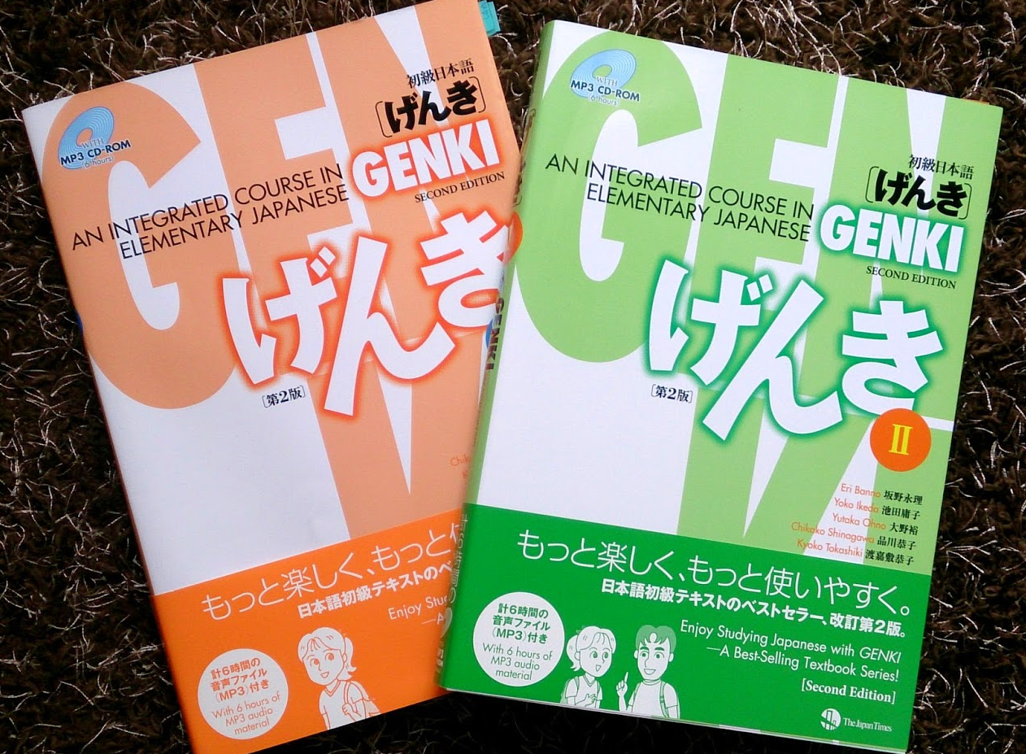
TEXTBOOK RESOURCES – Genki I and II
PROS
Has an accompanying workbook for practice.
Fairly comprehensive for a beginner-level textbook .Should take your right to the gates of Mordor Intermediate level Japanese.
Clear and concise, easy to use.
CONS
Meant to be used alongside a teacher or classes.
A little expensive compared to others.

Slide 17
TEXTBOOK RESOURCES – Dictionary of Basic/Intermediate/Advanced Grammar
PROS
In-depth and exhaustive (if you own all three)
Useful for learning how to differentiate between other, similar, grammatical forms.
Many example sentences, with English translations and explanations throughout.
CONS
A little expensive compared to other textbooks – around 4000 yen.
For serious learners, owning all three is a good idea (Advanced is perhaps only needed for those studying the JLPT or more serious stuff)
Not textbooks per se, but more of a reference – you’ll need other grammar resources for studying alongside this.

Slide 18
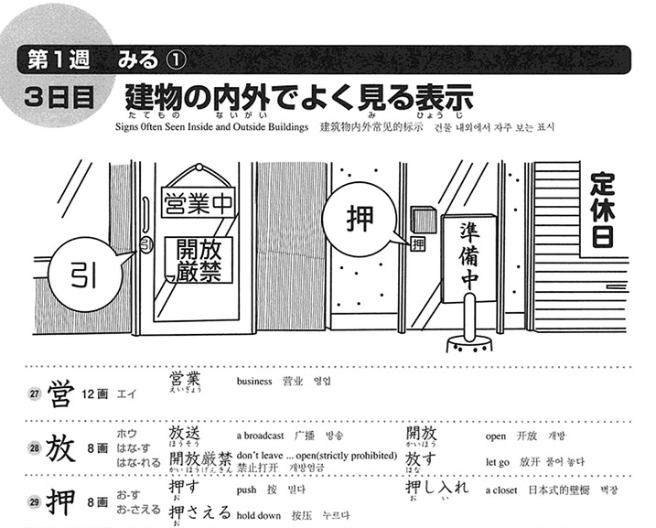
TEXTBOOK RESOURCES – Sou Matome Series
PROS
Easy to use
Simple layout
English translations
Good as an intro
Organized into 8 week chunks, so easy to keep to a schedule
CONS
A little too simplistic, especially for advanced learners
Needs to be backed up with other resources. Often need to look stuff up elsewhere to get a firmer grasp on things.
*N.B. N3-N1 has individual textbooks for grammar, listening, kanji etc. whereas N4 and 5 is just one collective volume

Slide 19
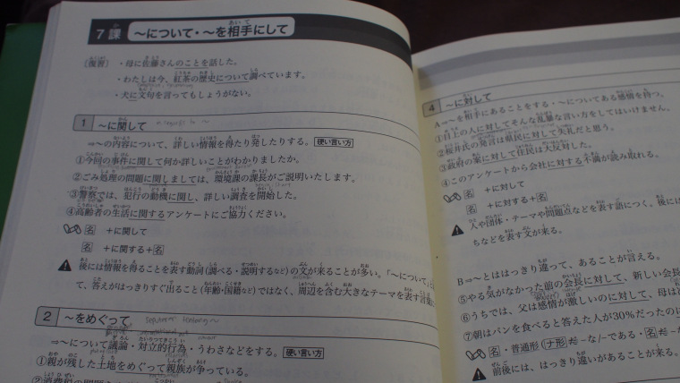
TEXTBOOK RESOURCES – Kanzen Master Series
PROS
All in Japanese, so no using English as a crutch. Helps with general reading speed and kanji ability too.
Japanese grammar explanations in Japanese, to aid understanding
Tells you when to use – and when not to use – grammar points, rather than just translating or explaining the English meaning.
CONS
All Japanese, so a higher barrier to entry than Sou Matome.
Reading ability needs to be a bit higher than other textbooks.
Not as beginner-friendly in terms of layout and graphics compared to others. Pretty dry and “textbooky”.
*N.B. Only available for N4 and onwards. N4 seems to have some English.

Slide 20
Internet Resources
Jisho.org https://jisho.org/
My go-to online dictionary. Easy to use and clearly presented. Has a variety of different functions, for example, searching for all words containing a certain kanji, searching by JLPT level, drawing an unknown kanji etc.
Goo https://dictionary.goo.ne.jp/
Just starting using this. It’s not as clear as Jisho but is arguably better for advanced learners due to providing Japanese-Japanese definitions. You want to use as little English as possible as you get better/quicker at reading and using Japanese.
Reddit https://www.reddit.com/r/LearnJapanese/ (and other related subreddits)
Useful to browse for five mins each day. Usefulness often depends on what other users post, but you can also ask questions of your own and get an answer. There’s also a Starter’s Guide with some helpful advice.
Japanese Stack Exchange https://japanese.stackexchange.com/
Similar to reddit, though a bit more study-orientated. Any time you have a question you should ask it here.

Slide 21
Internet Resources cont.
Anki/SRS
As previously mentioned, it’s also a phone app, a desktop app and a website.
iTalki https://www.italki.com/home
This is cheating a little as it’s not really self-study, but online lessons with a teacher.
NHK Easy https://www3.nhk.or.jp/news/easy/
Useful for advanced beginners up to intermediate (JLPT N4 and N3). These are news articles, but skewed towards simpler Japanese. You get furigana above the kanji, you get names of people, companies or places highlighted to make them easier to discern and you get definitions of tricky words. You can also listen to the article being read, as well as being able to turn off the furigana to make it more of a challenge. My approach when I started reading articles was to focus on international news I was already aware of in English. This helped with reading speed and figuring out what new words could mean.
NHK https://www3.nhk.or.jp/news/
The “proper” version of the news. When it’s time for big school. Often accompanied by a video of the news in question with a voice over, so you can study the article and then practice listening. I find the articles here easier to read than a newspaper, with the added benefit of being able to easily look stuff up online.

Slide 22
Internet Resources cont.
Tae Kim’s Guide http://www.guidetojapanese.org/learn/grammar Imabi https://www.imabi.net/
Decent grammar guide for beginners. Available on the website, in PDF form and also now in an app. Has a lot of English, but useful for people starting out and teaches you the basics you’ll need to progress. Imabi seems to be similar and goes to a more advanced level, haven’t used it personally.
Tofugu https://www.tofugu.com/
The Don Quixote of Japanese study sites. Has a lot of info strewn all over the place, as well as a Kanji SRS tool (Wani Kani) and a online textbook of it’s own. Has a lot of information about Japanese culture too. I find it uses too much English and is quite wordy, but it’s a pleasant site to use. Be careful, if you’re studying, to be actually studying – not just reading about study Japanese.
Satori Reader https://www.satorireader.com/
Online articles with a variety of settings and functions, mainly for intermediate learners. Could be useful for those wanting to read non-fiction, but who are not quite ready for the daunting task of a novel. Can be synced with Wani Kani too. Has various tools to make reading easier, such as furigana, looking up a full translation etc. Possibly more interesting content than just news articles. More suited to intermediate learners than advanced.

Slide 23
Youtube
There are a ton of channels out there for learning Japanese.
Nihongo no Mori
Has videos covering all the various JLPT stuff.
Dogen https://www.youtube.com/user/Dogen
His pitch accent series is good for learning correct pronunciation, though you will need to subscribe to his Patreon for all those videos. He also does loads of little comedy skits in Japanese too. Generally held up as having a pretty bang-on accept for a puny gaijin.
Japanese from Zero
The channel accompanying the textbooks. I watched these back home before coming to Japan and they are fairly entertaining and lightweight. Not great for intensive or advanced studying, but good for beginners.
A word of warning about YouTube – make sure you’re actively studying, not just passively watching. There are quite a few interesting channels about Japan/Japanese learning that can contain a few about of English. Don’t let these replace actual listening practice.

Slide 24
Phone RESOURCES
Duolingo https://www.duolingo.com/course/ja/en/Learn-Japanese-Online
Never actually used this for Japanese – there wasn’t a course when I first started – but have used it to learn other languages. Very user-friendly. Not sure if it would be suitable for intermediate learners and beyond though.
Memrise https://www.memrise.com/
Similar to Duolingo but this has user-created courses and has a much wider range. There are decks for all JLPT levels, as well as core vocab and grammar etc. As courses are user-created, you’re at the mercy of the content creator so quality can be a little variable. You aren’t able to tailor the flashcards to your own style like with Anki.
Hello Talk app
Designed to help people find others learning their language, and to find native speakers of your target language. Useful for writing messages and getting some correction, which can be quite hard in everyday conversations. You can write blog-style posts, message people to chat and even have a phone conversation if you wish. A word of warning though – some people do use it as a dating app.

Slide 25
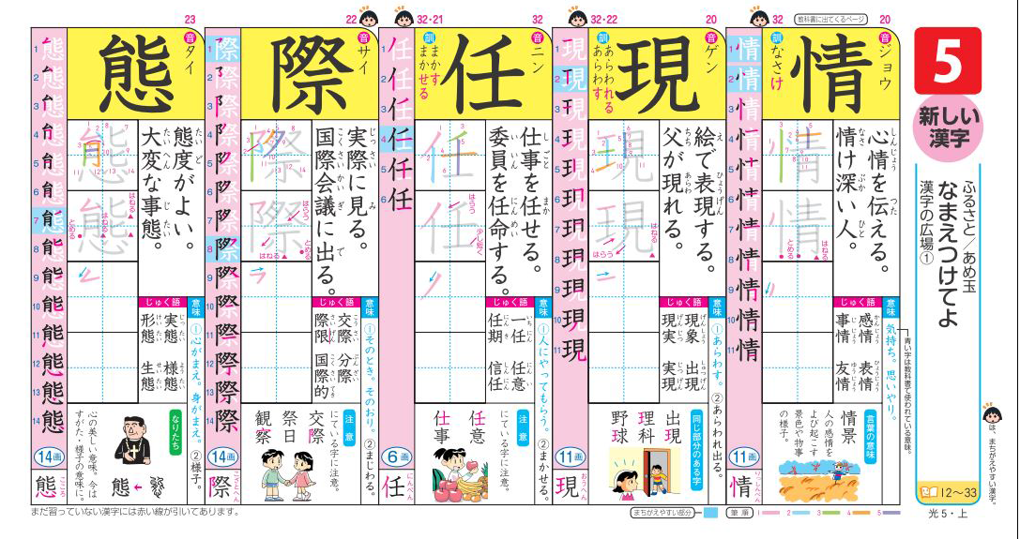
School Resources
Real life human beings
School libraries
Worksheets from English class
Those kanji drill books the ES kids have (漢字ドリル）
I was given a load of this by the secretary at my ES when she saw me studying. You might have seen your students using them, but they have them throughout ES so you get quite a wide range of kanji. You’ll learn them like the kids do – rote memorization – but you do get to practice writing them, introduced to other words that use the same kanji and you get to see them in sample sentences.
Sitting in on other classes
If you have a good relationship with other teachers and a high enough listening level, you can ask to stand at the back of other classes. I’ve done it in Social Studies classes and you see a lot of JLPT N2 and N1 vocab at JHS. ES Japanese classes are good too, and I’ve even joined in in a 2nd grade calligraphy class. Was good for my self-esteem knowing more kanji than a six year old.
School circulars and notices
You know those weekly notices you get on your desk which contains loads of indecipherable nonsense? Well they can be quite useful for learning work or school-related words. I used to give them a cursory glance and see if any words were repeated frequently or, once my level got a little higher, would try and read the odd paragraph. Also useful for figuring out what is going on at work and can be a topic of conversation. Though it’s often just indecipherable nonsense.

Slide 26
REAL LIFE RESOURCES
Netflix
If you use Japanese Netflix, there’s a wealth of stuff on there. It has English subtitles for beginners, and Japanese ones for intermediates. Its one big advantage over live TV is the ability to pause and rewind, which make it a much better learning tool.
TV
Not as useful as Netflix but still handy. Especially if you like shows about food and the reactions of Japanese C-list celebrities.
Anime
Not something I personally use, but it’s something that a lot of people have an interest in. There are a lot of them on Japanese Netflix and you’ll get subtitles and that precious, precious rewind/pause function. Again, make sure you’re studying instead of just watching – keep a notebook handy for unknown words, practice shadowing etc.
Videogames
Book Off and similar stores have cheap second hand games. Just be it’s actually studying and not playing. Some games for kids might be all-hiragana too, so make sure to pick one that matches your level.
Books/Manga
Again, plenty of places sell these second hand. With books, be careful not to overreach and go for something too difficult or time-intensive. Certain manga are probably guilty of having a lot of made-up words, so be careful of those.

