Slide 1
Visa RenewAl
The Day of Sitting and Waiting

Slide 2
OG’s visa explanation
http://www.immi-moj.go.jp/english/tetuduki/kanri/shyorui/03.html
Can be found on Gifu Weebly
● Will need to renew at the end of your third year (generally. Verify your dates just in case!)
● Can only start 3 months before expiration date
● Details on how to apply found here
● Recommended you have a passport with more than 3 months left (more is better!)
● You will receive a temporary extension when you apply, but you must apply before your visa expires!
● Your BOE (maybe supervisor) has to fill out a page of the form.

Slide 3
The three places you can apply
● The Gifu Branch of the Nagoya Regional Immigration Bureau (in Gifu City, near Media Cosmos, not busy)
● The Toyama Branch, (at Toyama Kitokito Airport)
● The Nagoya Regional Immigration Bureau itself (Not recommended, crowded and busy)
Gifu City Branch
Toyama Branch
Nagoya Regional
500-8812 2-7-2, Mieji-cho, Gifu City, Gifu
939-8252 1st floor, Toyama Airport Bldg., 30 Akigashima, Toya-ma City, Toyama
455-8601 5-18, Shoho-cho, Minato-ku, Nagoya City, Aichi

Slide 4
What you’ll find on the site
http://www.immi-moj.go.jp/english/tetuduki/kanri/shyorui/03.html

Slide 5
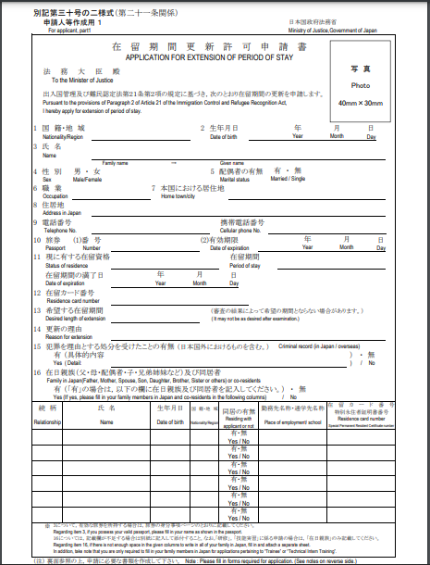
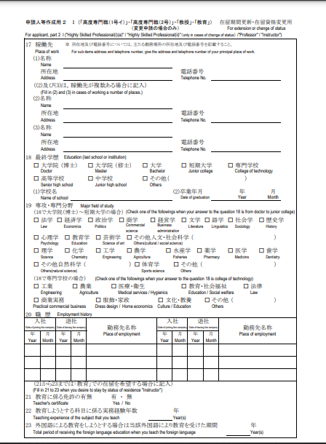
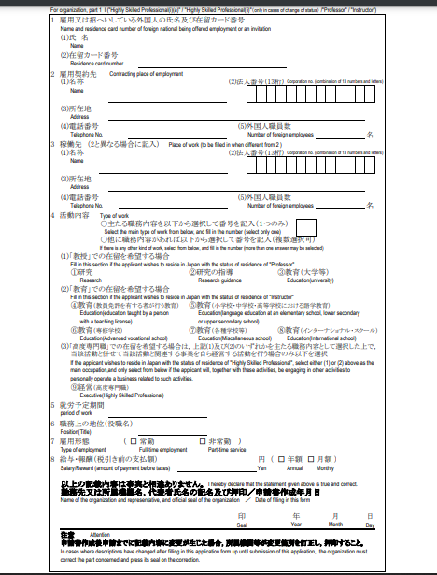
The documents, a snapshot
You fill these out
Your school/BOE fills this out

Slide 6
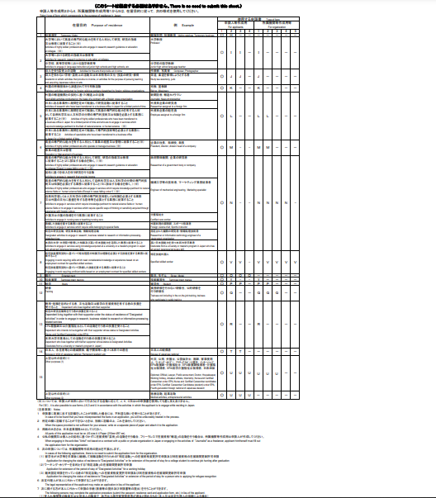
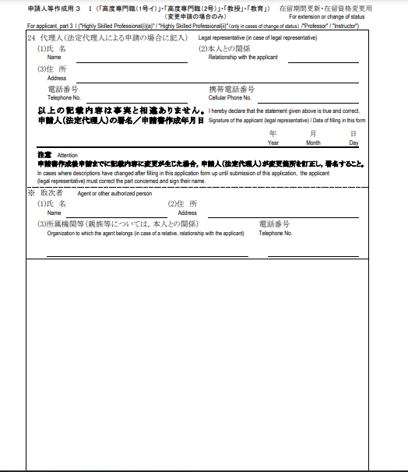
The documents, a snapshot
You (probably) don’t need this one!!
You don’t need this one!!

Slide 7

do as I say, not as I do’s
Apply for 5 years
Revenue stamps from PO
Sign-in when you arrive. You get a number to hold onto and then return when you leave
The office may not be on the first floor
Get in line ASAP
There is an English post card
For the love of god, bring an automated fan and cooling wipes

Slide 8
Know your rights!
(Special leave)
Article 11
(1 [unlabeled]) – (4)
Special leave shall be provided for the ALT for the periods set out in the following items: i. – xix.
xviii.
(e.g. for Foreigner Registration, visa-related applications): the period of time the Supervisor deems necessary.
Any other time as designated by the Supervisor
The period of special leave specified in Section 1 above from Item 2 [ii.] to item 5 [v.] and in Item 18 [xviii.] and in Item 19 [xix.] is to be paid, and the period of Item 1 [i.] and that from Item 6 [vi.] to Item 17 [xvii.] is to be unpaid.
(3)
Memo~ Refresh yourself on your contract every once in a while

