Slide 1
Preparation for Leaving JET
Hayley Wallace
International Relations Division
Sam Keane
Education and Training Division

Slide 2
Overview
1. Pre-departure preparation
2. The departure process
3. Post-departure and questions
Breaks in-between!
Information specific to prefectural or municipal JETs will be signposted

Slide 3
Consultation Forms
You will each receive a consultation form
If you have any questions or concerns that you feel need PA assistance with during the session, you can write your name and questions on the form and submit it
PAs will consider this the beginning of a consultation and will get in touch with you after SDC
You may also write down your planned route to be checked regarding flight cost reimbursement

Slide 4
Pre-Departure Preparation

Slide 5
Apartment Prep
Begin cleaning out your apartment as early as possible (it will take longer than you expect).
Start at least 2 months in advance before you are planning to leave.
Confirm with your schools/BoE the arrangements for your apartment.
Inform your landlord that you will be moving two months in advance.
Notes:
１．Create a timeline for yourself.

Slide 6
Apartment Prep Continued
Inform your landlord as soon as you decide on your moving date, as the date may affect final rent calculation
Prefectural BOE: Submit moving-out notice to the prefecture through your schools. Also tell your apartment representative about your moving-out and consult how and when to return your apartment keys

Slide 7
Conditions for leaving possessions
(Prefectural BOE) Possessions can only be left in your apartment in two possible situations:
If you have written agreement from your successor that they will take your belongings (requires an itemized list)
Your successor is going to live in your apartment (please ask your school).
All expenses regarding moving out are to be covered by the JET, no reimbursements are possible

Slide 8
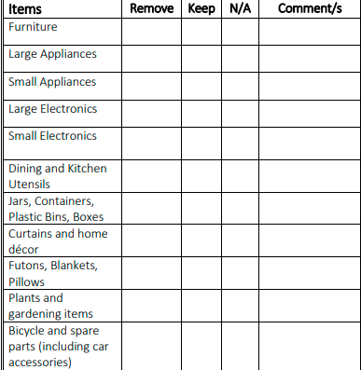
Itemizing Apartment
Make categorized lists to start the reckoning of what all you will be dealing with.
If you struggle to get started with getting organized, the Apartment Clean Out Declaration PDF on our website could be a good springboard.
You might also try itemizing room by room, i.e., Kitchen, Living, Bathroom, etc.

Slide 9
Departing from Prefectural Employee Accommodation
When your moving-out date is set, submit a Notice to Vacate form to the Prefecture through your school ASAP
Return your accommodation to its original condition
Do not leave anything for your successor without their written permission
Clear with your accommodation representative your moving-out plans, including when you will be handing over your keys
You will also need to submit a Departure Confirmation List confirming that you have met all your tenant responsibilities
ASK YOUR SCHOOL OFFICE FOR THESE DOCUMENTS

Slide 10
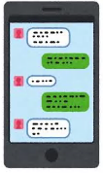
Selling Items
Start asking around sooner than later!
Employ resources like JET Facebook Groups (JET Ladies+, regional groups, etc.) to find potential buyers.
Let people know upfront if prices are non-negotiable and make sure they/you are able to commit to transporting items.

Slide 11
Throwing Out Items
Should also ideally be done gradually and not all at once.
Do not neglect procedure because you are in a rush.
Some stores like Yamada Denki offer pick-up disposal services – ask around school and your JET community to see what might be options nearby.

Slide 12
Disposal of Large, Electronic, and other Miscellaneous Objects
For Gifu, Sodai Gomi or large object disposal includes: Household appliances, furniture, futons, bicycles, tricycles etc.
Items that cannot be thrown away are refrigerators, freezers, air conditioners, TVs, washing machines, drying machines, etc.
There are quite a few pieces of information and guidelines to review so please visit your official city webpage for more details and follow the guidelines

Slide 13
Disposal of Large Appliances
There are a number of services that take away large appliances
Electronic shops (Yamada Denki, Edion etc.)
Some municipalities
Recycle Shops (2nd Street, Santa no Souko, etc.)
If using recycle shops, make sure your appliances are cleaned up and in decent shape

Slide 14
Ask permission to leave items (BOE requires written proof)
Same as with selling to others, if you are selling things to your successor, practice honest and transparent communication.
Do not let your actions become someone else’s JET move-in horror story.
Leaving Items for Your Successor

Slide 15
Discussion Break:
How is your apartment prep going?

Slide 16
Contact with your Successor
PAs will disseminate handover forms
Please include your preferred contact method in the form (Line, email, etc.)
While your successor will have lots of questions for you, please refer them to the PAs for questions related to employment and the arrival process!

Slide 17
Vehicles
Disposing of your car or selling it to another individual requires filing the appropriate paperwork with the Land Transport Office.
The 2022 Edition of the General Information Handbook for details regarding buying and selling vehicles, so please give it a look! See p. 127.
For bike owners: when giving your bike to a friend/successor, make sure to perform bike ownership transfer procedure

Slide 18
$ Expenses and Utilities $
What payments will you have left?
How will you make those payments?
Start making a game-plan for each payment!

Slide 19
Cancelling Contracts
Please note that while some services can be cancelled online or over the phone, cancelling your cell phone often requires you to visit the store in person to cancel your contract.
Know sooner than later about the cancellation fees you might be incurring.

Slide 20
Cancelling Contracts
Check when your final bill will come
Consider changing your payment method from direct debit to cash payment at the convenience store
Calculate or estimate how much money you will need to set aside for final payments

Slide 21
Planning Financially
Plane tickets need to be paid for in full
Shipping belongings can reach high costs per parcel depending on postage and shipping method
Electronics utilities (phone contracts, internet etc.) often have cancellation fees to be paid from your bank account depending on your contract

Slide 22
Paying Residence Tax （住民税）
For those staying in Japan: properly performing moving-out/moving-in procedures at city hall sufficient
For those leaving in August: full payment will be withdrawn from your salary before departure.
For those leaving in April: bill is issued in June, JETs should transfer the cost to a appointed tax agent and have them pay on their behalf
BE PREPARED FOR A BIG FINANCIAL HIT

Slide 23
Closing your Bank Account
In person is fast and any remaining funds will be issued in cash
Bring the following to your bank branch:
ID
Bank Book
Bank Card
Inkan
“Kouza o kaiyaku shitai desu”: I would like to close my account.

Slide 24
Notes about banks
Many of the local Gifu banks have sparse coverage outside of the Tokai region, consider changing if you are moving outside of Gifu
Check your bank’s money transfer procedures or use a remittance service (Wise etc.)
(Prefectural BOE) Reimbursement for flights always comes in a few days before final departure and is issued to your bank account.
For municipalities, the timeline will vary so make sure to ask your BOE for an estimate.

Slide 25
Discussion Break
Do you know what needs cancelling?
When?

Slide 26
The Departure Process

Slide 27
Leaving Gifu: Two weeks before moving out
Submit Notification of Moving Out(転出届/Tenshutsu Todoke) at municipal office
If you are staying within Japan, apply for a change of address registration (転居届/Tenkyo Todoke) at your local post office
Most offices will have an English template for you to use as reference, but examples are also available online
As a rule, bring your residence card, inkan and public health insurance card (MyNumber Card if you have one)

Slide 28
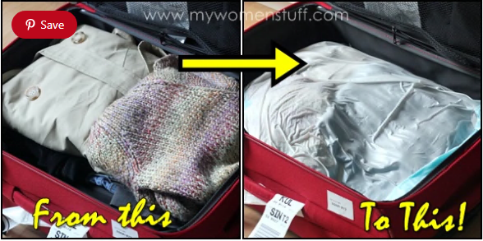
Packing Advice
Pace it out. Go through practice-runs where you pack everything and weigh-in the results.
Minimize, especially with clothing and things you can easily and cheaply replace at your next place of residence.
Probably old news to many, but vacuum bags can make a night and day difference in luggage space!

Slide 29
Moving within Japan
Upon submitting your Notification of Moving Out you will receive a Moving-Out Certificate (転出証明書/Tenshutsu Shoumeishou)
When moving in to your new municipality you will need to submit this along with the usual documents
As we have been moved to a Mutual Aid Fund for Prefectural BOE staff you will need to re-register with Public Health Insurance when starting your new job (or your new job’s health insurance provider)

Slide 30
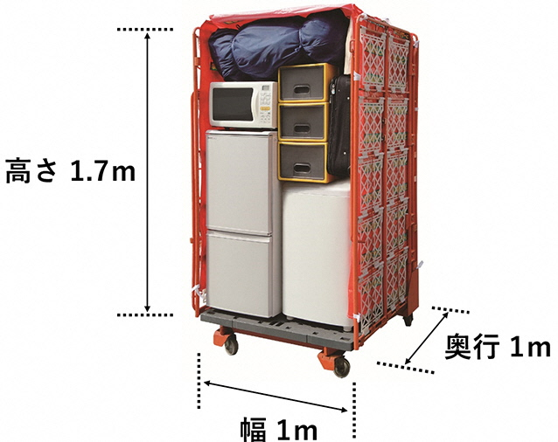
Moving Companies in Japan
Sites like Hikkoshi Samurai offer quote comparisons
Packing options varies between companies- pick what works for you!
Some companies advertise themselves as having English language support or staff (NOT AN ENDORSEMENT):
Best Moving Service
Yamato Home Convenience
PROROW Transport
Allied Pickfords

Slide 31
Leaving Japan: Return Airfare
Fundamentally, JET Programme participants who meet the following requirements are eligible to have their flights reimbursed:
Completed term of appointment
Will not enter a subsequent term of appointment/employment with their contracting organization or a contract with a third party in Japan within one month of completing their term of employment.
Leaves Japan to return to their home country no later than one month from the day following the end of the term of appointment.

Slide 32
Prefectural BOE Regulations
The BOE will pay for the cheapest, most direct flight from the nearest international airport with flights to the original departure airport
JETs should buy the ticket via cash or bank transfer from a travel agency (credit card, debit card, electronic payment not accepted)
When buying, ask for a printed estimate (見積もり/Mitsumori) and proof of purchase
Examples of travel agencies used include JTB, Nippon Ryoukou and HIS

Slide 33
Prefectural BOE Regulations cont.
The BOE will also reimburse transit to the Japanese airport from which you are flying from
Once you have bought your plane ticket you will submit a Return Travel Itinerary Form to your school (Get from your schooloffice)
The reimbursement comes a few days before your stated day of departure so please keep your bank account open until this time

Slide 34
Discussion Break
Do you understand your CO’s requirements for reimbursement?
Do you know your flight plan?
Are you ready for your move?

Slide 35
Regarding Covid-19
Even as various countries (including Japan) begin moves to downgrade the virus, sudden waves of infection may require countries to change travel restrictions
If you have lost your vaccination certificate from your original jab, you can ask your city hall to issue a new one, or use your MyNumber Card to register with the official Novel Coronavirus Certificate app.
Keep an eye on your home country’s border policies, and research how to get your Japanese certificate recognized or re-issued as a local certificate

Slide 36
Post-Departure

Slide 37
Lump-Sum Pension Withdrawal
What to do with your pension fund?
If your country has an equalization treaty, apply to have your pension payments recognized in your home country’s pension system
Apply to have a portion of your payments paid back to you

Slide 38
The Process
For those seeking tax reimbursement: register your tax agent at the tax office before leaving
Return from Japan
Download the application form from the nenkin.jp website
Fill out the form and post it back to the Japan Pension Service along with your Pension Booklet/Basic Pension Number Notice and a photocopy of your passport

Slide 39
Payment and Tax Refund
PROCESSING TAKES SIX MONTHS AND MAY BE REJECTED DO NOT PLAN ASSUMING THE PAYMENT IS CONFIRMED
PAYMENT IS ISSUED TO YOUR BANK ACCOUNT IN LOCAL CURRENCY BASED ON CURRENT EXCHANGE RATE ON DATE OF TRANSACTION
TWO YEAR TIME LIMIT ON APPLICATION
Notes:
Processing takes about six months or more. If you are planning financially, we recommend treating the payment as a windfall and not a sure thing
The payment is calculated based on the number of contributions and time spent in Japan, and is issued in your local currency to your bank account
This payment is taxed, however the taxed portion can also be claimed back

Slide 40
Lump-Sum Tax Refund
Appoint someone in Japan as your tax agent with a letter of attorney (before leaving!)
Have them submit a tax refund application to the tax office in your name
The refund will be paid to the agent’s bank account, and from there they transfer the refund to you
NB: The tax refund requires both the use of free time on a weekday and the submission of personal information and bank account details by the agent. This is not a work duty for your supervisor.

Slide 41
Discussion Break
How are you feeling about your time on JET ending?
Do you know what your next goals are?

Slide 42
JET Alumni
JETAA International is a group with expansive chapters that work to support JETs all over the world.
AJET (Association for the Japan Exchange and Teaching Program)
https://jetprogramme.org/en/former/
JET has information on its official website for JET Alumni including a currently running newsletter, information on internships, and more.

Slide 43
Job Hunt Information
Make sure to suss out any new company or organization – I always use Reddit or Glassdoor.
For Japanese jobs, beware of ブラック企業 (burakku kigyou).
The same official JET website has a FAQ that answers questions about letters of reference, writing Japanese resumes, career fairs, etc.
There are many online directories for foreigners seeking jobs in Japan – please see the handout for a list of sites.

Slide 44
Mental Health during Transition
Just as it was when you first came onto JET, expect a state of emotional flux with a plethora of highs and lows.
Make sure that no matter how frenzied the pace might be that you are taking time to center yourself.
Be aware of possible stigmas such as people mistaking your time here as a few years of leisure or studying abroad

Slide 45
Having a Game Plan
Though of course there are many situations involving returning home without a game plan, it’s ideal to have at least some sort of new path or objective lined up.
It can be easy to suddenly feel marooned in your own home country – or as if you’ve actually made a mistake returning home.
Savings and pension money can also run out in no time if you’re not careful.

Slide 46
Reverse Culture Shock
Reverse culture shock can resemble initial culture shock to a T. Some symptoms include:
Frustration, Boredom, and Restlessness
Changes in Goals and Priorities
Depression
Strong Change in Opinion or Feelings About One’s Own Country
*Symptoms referenced from the United Studies Abroad Consortium

Slide 47
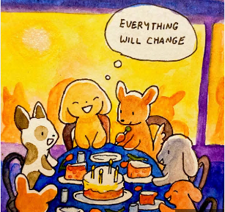
@annalaura_art on twitter, Instagram, etc.

Slide 48
Conclusion
Preparing for your departure from JET is a mammoth task no matter your next move
Preparation and patience will keep you organized and mentally well
Stay coordinated with your schools and keep talking to your PAs
Be kind to yourself as you take on this next great challenge

