Slide 1
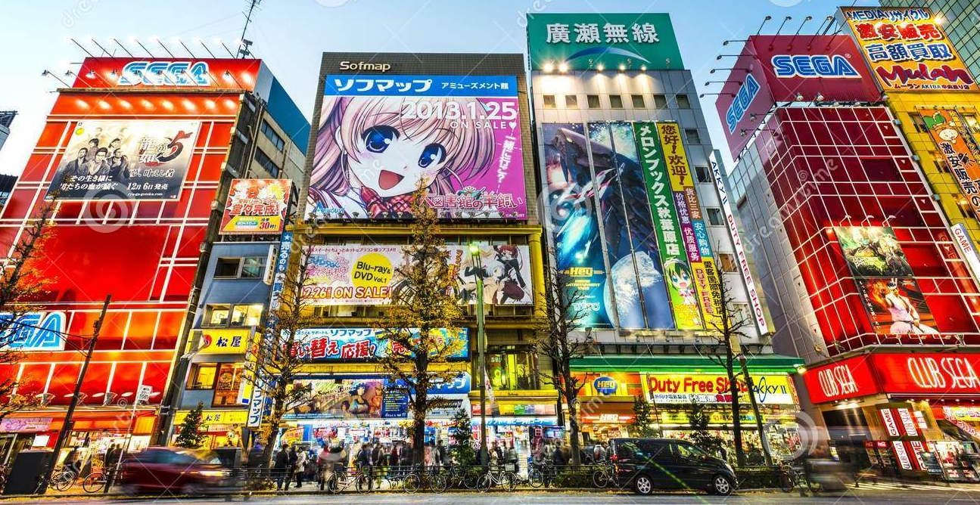
Pop Culture Fun Time!

Slide 2
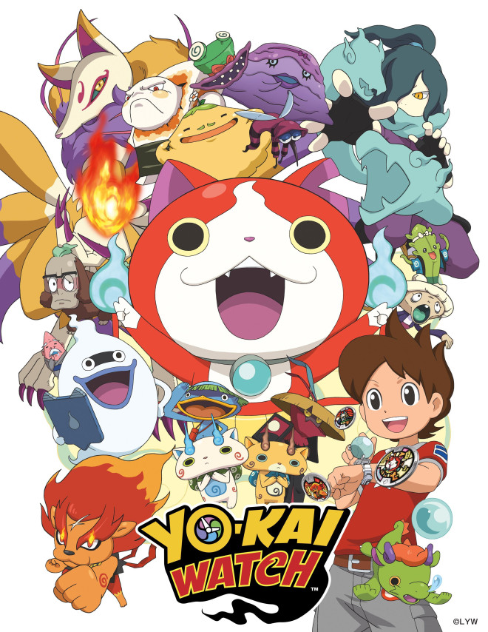
Yo-kai Watch
Using a special device known as the Yo-kai Watch, a boy named Nate is able to identify and see various different Yo-kai, or spirits. Joined by the cat Yo-kai Jibanyan and Whisper, Nate and Whisper start befriending all sorts of Yo-kai which Nate can summon to battle against more ill-intentioned Yo-kai that happen to live in his town, causing terrible trouble.
This is popular with elementary students.

Slide 3
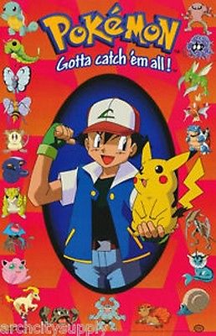
Pokémon
A series of video games and anime about fictional creatures called "Pokémon", which humans, known as Pokémon Trainers, catch and train to battle each other for sport.
Be careful referencing this in class though because some JHS are trying to ban the playing of Pokemon at school now!

Slide 4
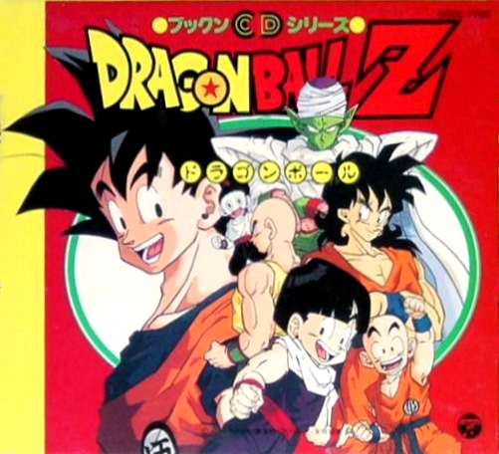
Dragon Ball Z
Follows the adventures of Goku who, along with the Z Warriors, defends the Earth against evil.
This began serialization in 1996, so it is well know by your teachers and students alike.

Slide 5
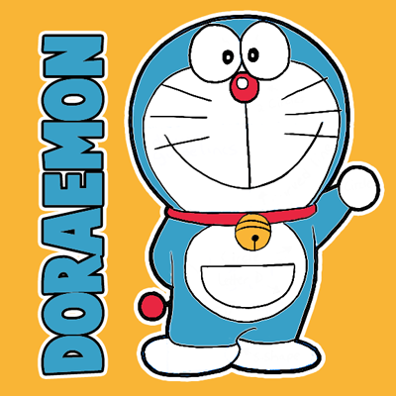
Doraemon
The story revolves around a robotic cat named Doraemon, who travels back in time from the 22nd century to aid a pre-teen boy named Nobita Nobu, who can't seem to do anything right.
Doraemon’s target audience are elementary students.

Slide 6
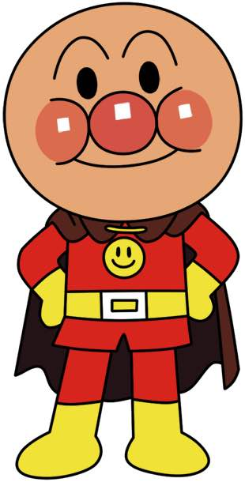
Anpanman
In each episode, Anpanman fights with Baikinman and helps the people of the town. He is a symbol of justice, fighting for the cause of justice every day.
Aimed at elementary students. In 2011, research found the titular Anpanman to be the most popular fictional character among people age 0 to 12 years in Japan in 10 consecutive years

Slide 7
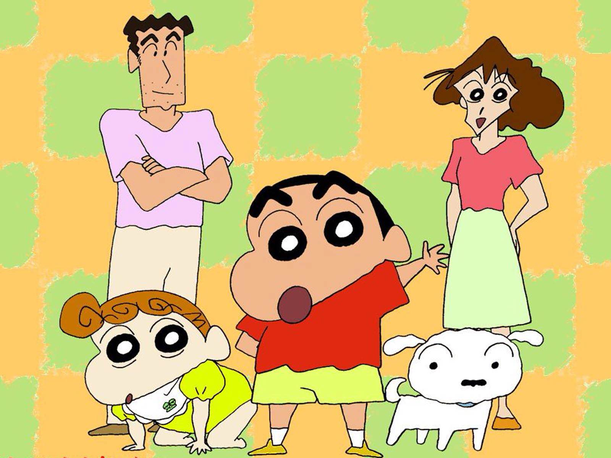
Crayon Shin-chan
It follows the adventures of the five-year-old Shinnosuke "Shin" Nohara and his parents, baby sister, dog, neighbours, and friends and is set in Kasukabe, Saitama Prefecture.
Crayon Shin-chan’s target audience are elementary students.

Slide 8
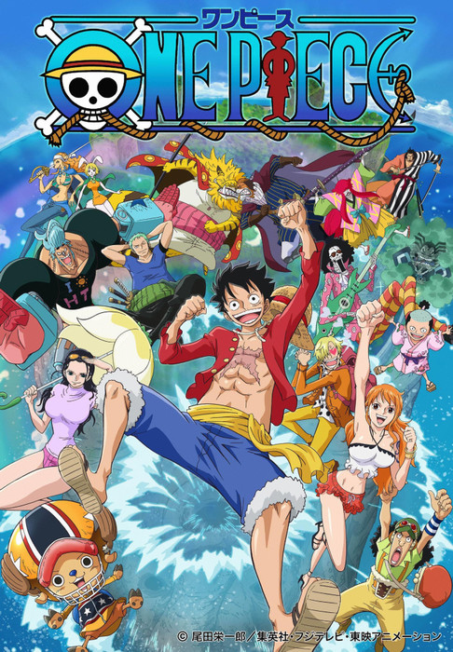
One Piece
Follows the adventures of Monkey D. Luffy, a funny young man whose body gained the properties of rubber after unintentionally eating a Devil Fruit. With his diverse crew of pirates, named the Straw Hat Pirates, Luffy explores the grand line in search of the world's ultimate treasure known as "One Piece" in order to become the next King of the Pirates.

Slide 9
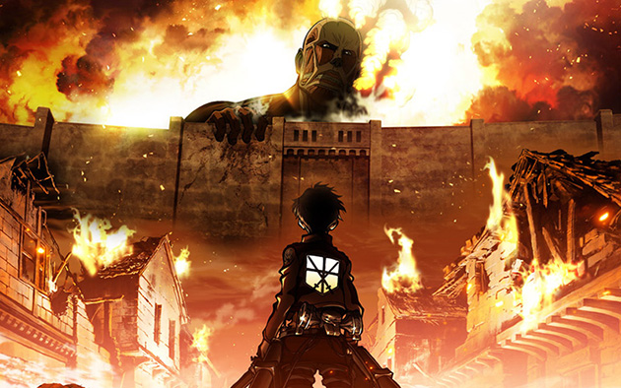
Attack on Titan
It is set in a world where humanity lives in cities surrounded by enormous walls; a defense against the Titans, gigantic humanoids that eat humans seemingly without reason. The story centers on Eren Yeager, his adopted sister and childhood friend, who join the military to fight the Titans.

Slide 10
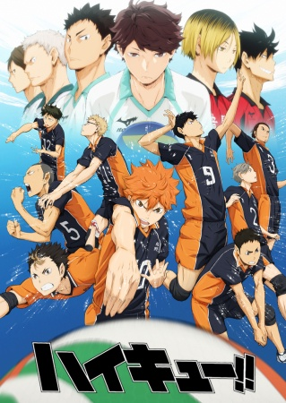
Haikyuu
Shouyou Hinata joins Karasuno High School's volleyball team—only to find that his sworn rival, Kageyama, is now his teammate. Thanks to his short height, Hinata struggles to find his role on the team, even with his superior jumping power.

Slide 11
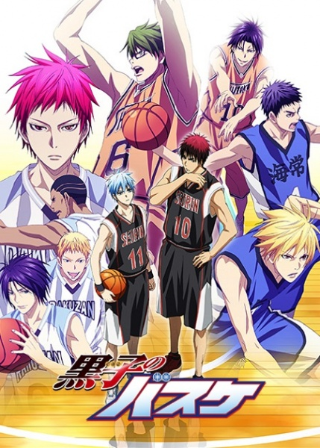
Kuroko no Basket
Focusing on Taiga Kagami, a promising player returning from the US, and Tetsuya Kuroko, a seemingly ordinary student whose lack of presence allows him to move around unnoticed, Kuroko no Basket follows the journey of Seirin High School’s players as they attempt to become the best Japanese high school team by winning the Inter-high Championship.

Slide 12
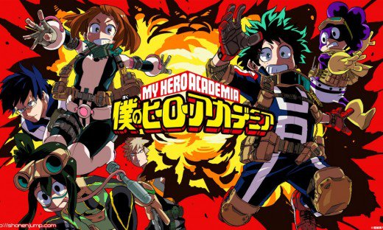
My Hero Academia
The story follows Izuku Midoriya, a boy born without superpowers in a world where they are the norm, but who still dreams of becoming a superhero himself, and is scouted by the world's greatest hero who shares his powers with Izuku after recognizing his value and enrolls him in a high school for heroes in training.

Slide 13
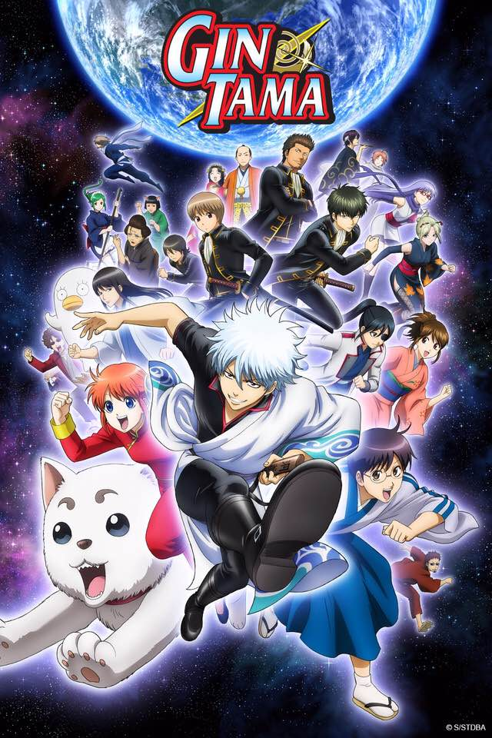
Gintama
Set in Edo which has been conquered by aliens named Amanto, the plot follows life from the point of view of samurai Gintoki Sakata, who works as a freelancer alongside his friends Shinpachi Shimura and Kagura in order to pay the monthly rent.

Slide 14
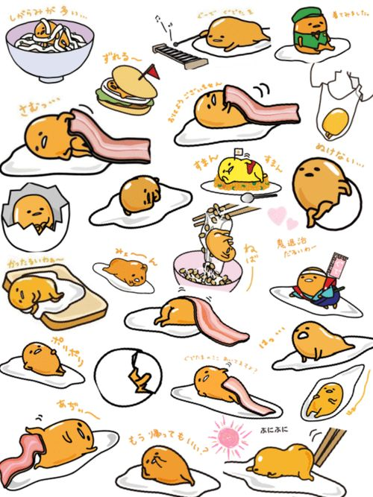
Characters - Gudetama
Gudetama is a Sanrio character introduced in 2013 based on an egg lacking in "spunk". His name is a play on "gude gude"; used to describe someone with no energy or strength and tama from tamago (egg).

Slide 15
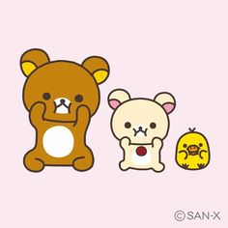
Characters - Rilakkuma
Rilakkuma's name is a combination of リラックス rirakkusu, a Japanese transliteration of the English word "relax", and クマ（熊）kuma, the Japanese word for "bear". He is often pictured laying around and relaxing.

Slide 16
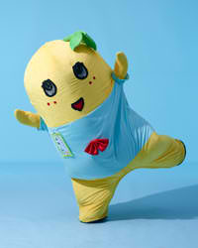
Characters - Funasshi
Funasshi is a Japanese mascot character, unofficially representing the city of Funabashi, Chiba. Unlike other mascots, Funasshi always speaks for itself. It also often shrieks, jumps, dances and makes violent movements like headbanging. When it speaks, it usually ends its sentences with "nasshi" (～なっしー) which sounds like the Japanese word for "pear" (nashi).

Slide 17
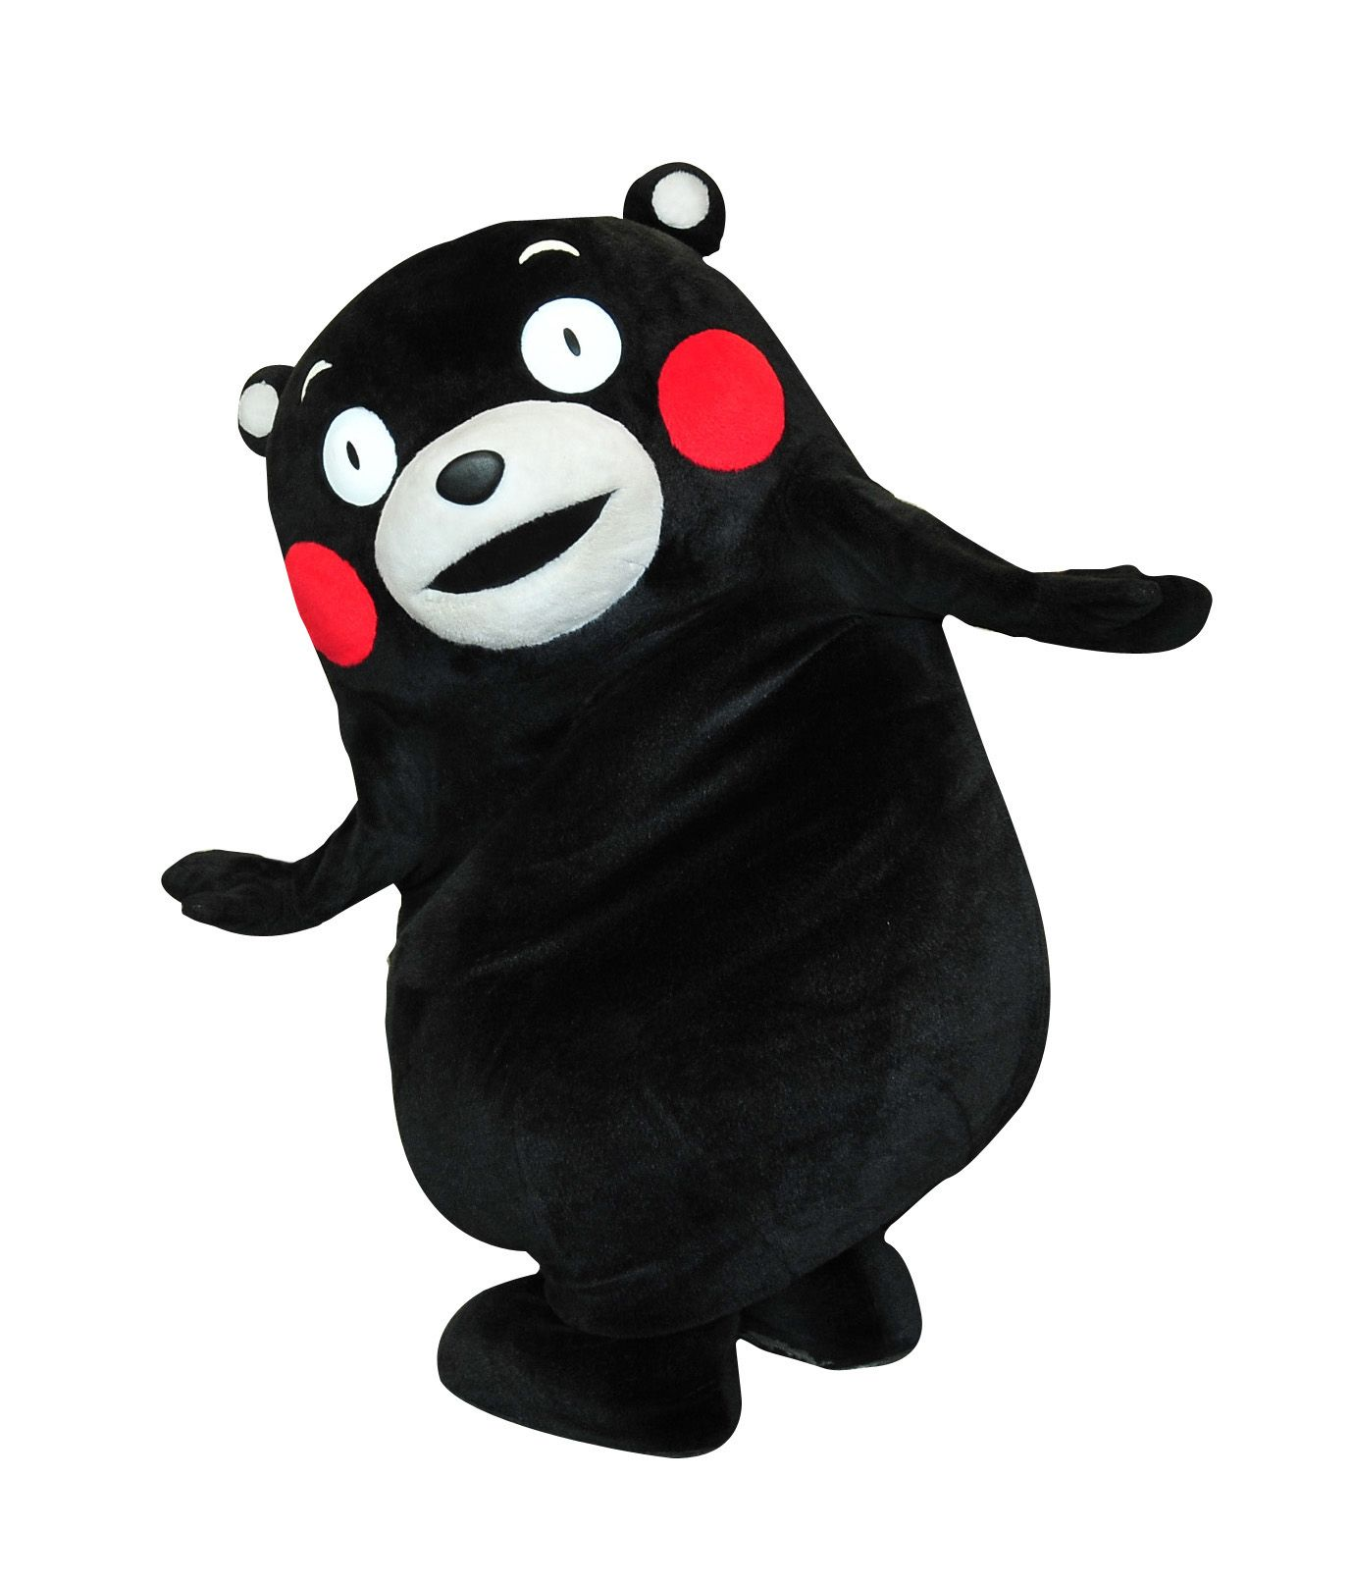
Characters - Kumamon
Kumamon (くまモン) is a mascot created by the government of Kumamoto Prefecture, Japan. In late 2011, it was voted top in a nationwide survey of mascots.

